Slide 1
Assignment 2: Dos and Don’ts
CS 7830 – Machine Learning

Slide 2
Do’s
Use Graphs effectively.
Comment your code.
Justify your conclusions with proper reasonings.
Submit a runnable and error-free code.
If you’re using any other language/tool, include a README file with steps to run your code.
Submit before deadline.

Slide 3
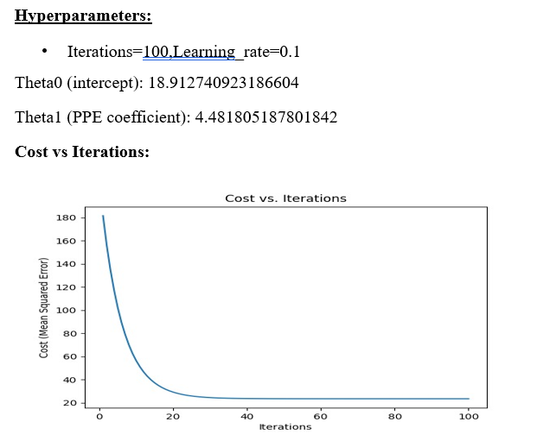
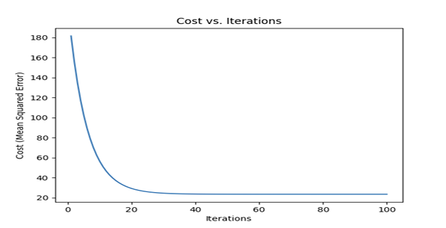
Don’ts
Do not use restricted libraries like Scikit-learn ,statsmodels, etc.
Plagiarism is strictly prohibited.
Don’t just simply paste your graphs in the report .
For example:

Slide 4
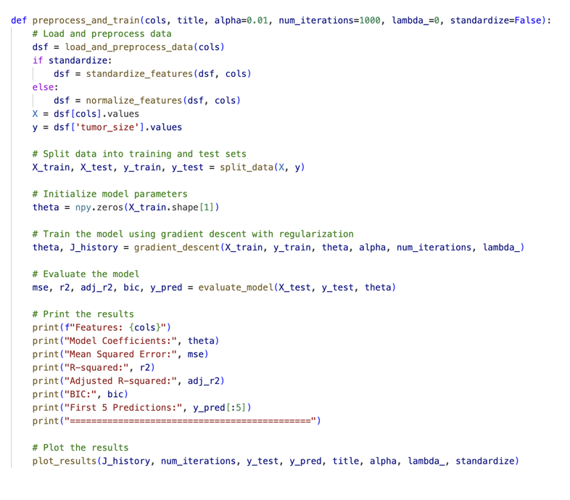
Some common issues wrt Assignment 1
Google Drive link :- Please ensure that the Google Drive link is set to public access.
Correct path to load your dataset.
Your report must be an analytical report.

Slide 5
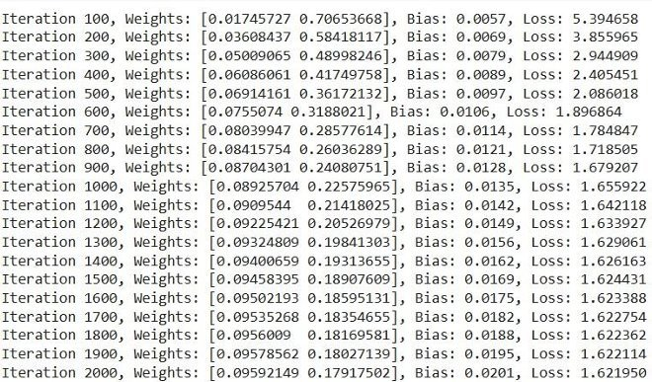
Don’t copy paste/ insert images of each iteration

Slide 6
Submission Instructions
Upload a zipped file named Assignment-2_YourName.zip to Dropbox.
Due date- 04/03/2025
Your zip file should include:
Dataset
Code file
PDF report
README.txt
All the best for your assignment ! Feel free to reach out for any clarification at merugumala.6@wright.edu.

